Slide 1

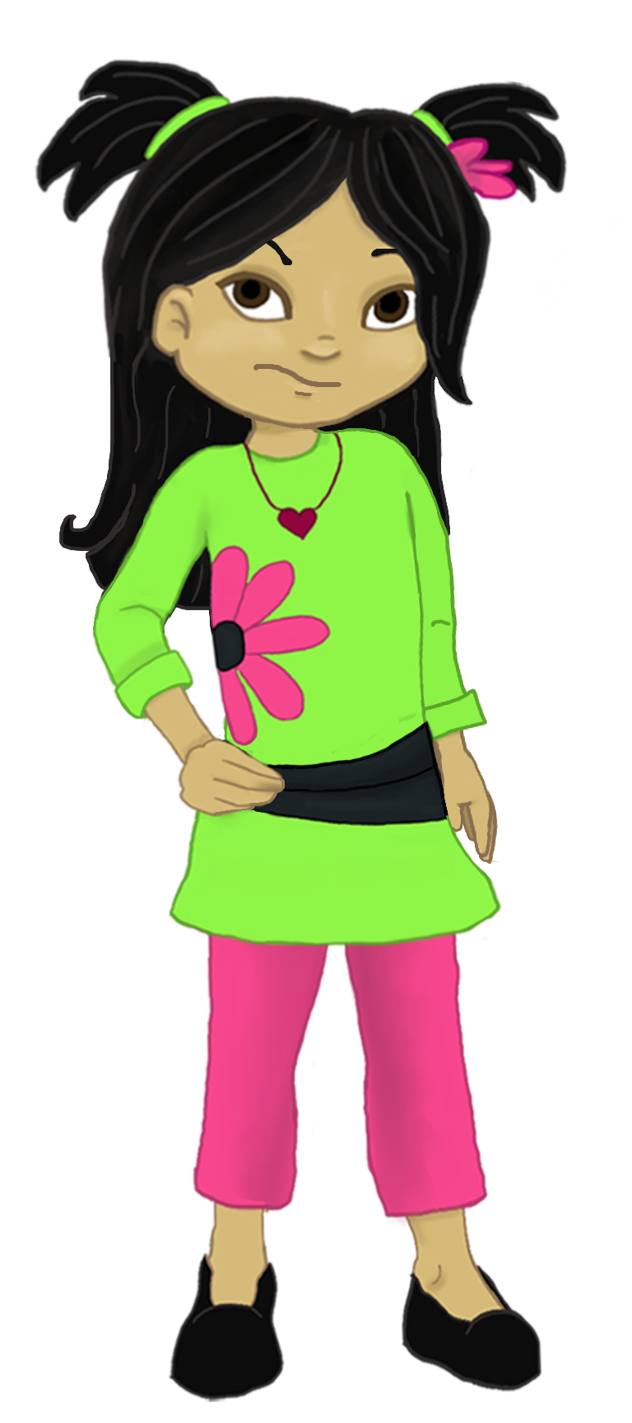
Welcome to:
Loving Solutions

Slide 2
Stay the Course
9
UNIT
It has to get dark before you can see the stars.

Slide 3
Objectives
9
UNIT
Discuss the process of change
Recognize methods of helping children feel capable
List strategies to promote family unity

Slide 4
Before We Begin
9
UNIT
Group Facilitator
Group Recorder
Group Time Keeper
Nurturers / Cheerleaders
Don’t forget to change roles!

Slide 5
Stories of Success
9
UNIT
Were you able to establish new bed times for your children?
What happened?
What junk food items did you remove from your house?

Slide 6
Activity 9.1: Let’s Focus
9
UNIT

Slide 7
Dynamics of Change
9
UNIT
Change is usually . . . .
Slow
Incremental
And Painful
For ALL concerned

Slide 8
Change
9
UNIT
Typically, the person who becomes the most frustrated, changes first.

Slide 9
Activity 9.2: Ahhh!
9
UNIT
What will success look and feel like?

Slide 10
3 Phases of Change
9
UNIT
Behavior gets worse
Behavior occurs less frequently
Behavior occurs less frequently and with less intensity as well

Slide 11
Activity 9.3: Worse May BE Good
9
UNIT
Screams at parent

Slide 12
Activity 9.4: Map Your Progress
9
UNIT
Phase 1?
Phase 2?
Phase 3?

Slide 13
Teaching New Skills
9
UNIT
Encourage and support child’s effort
Don’t expect or demand perfection
Break it down
Celebrate success
ALWAYS Praise your child’s effort

Slide 14
Activity 9.5: Influencing Our kids
9
UNIT
You are loved:
You are secure:
You are an individual:
You matter to me:
You are capable:

Slide 15
Choices
9
UNIT
Choice + Responsibility = Growth
or
We learn from our mistakes

Slide 16
Choices
9
UNIT
“Nobody ever did, or ever will, escape the consequences of his choices.”
-Alfred A. Montapert

Slide 17
Problem Solving
9
UNIT
Help your child identify the problem
Help your child brainstorm possible solutions
Help your child identify the probable outcomes
Help your child choose a plan
Later . . . Evaluate the plan

Slide 18
Family
9
UNIT
A strong sense of family is NOT developed by accident!

Slide 19
Activity 9.6: Supporting Family
9
UNIT
The family that PLAYS together:
The family that together:
The family that together:

Slide 20
Activity 9.7: Participation
9
UNIT
Involve child in important family discussions
Ask for their opinion
Invite child to help create family rules

Slide 21
Difficult Situations
9
UNIT
These battles MUST be won!

Slide 22
Activity 9.8: When Parents Give In
9
UNIT
Angela Dylan

Slide 23
Activity 9.14: Key Points
9
UNIT
1. Parents should _____________ enforce their limits and house rules.
2. Parents must set aside time with their children to focus on the ______________ .
3. Parents should ____________ before they speak and _____________ before they act.
4. For parents who ____________ to give up, ________________ is possible.
positive refuse plan think
^{consistently everything}

Slide 24
Most Powerful
9
UNIT

Slide 25
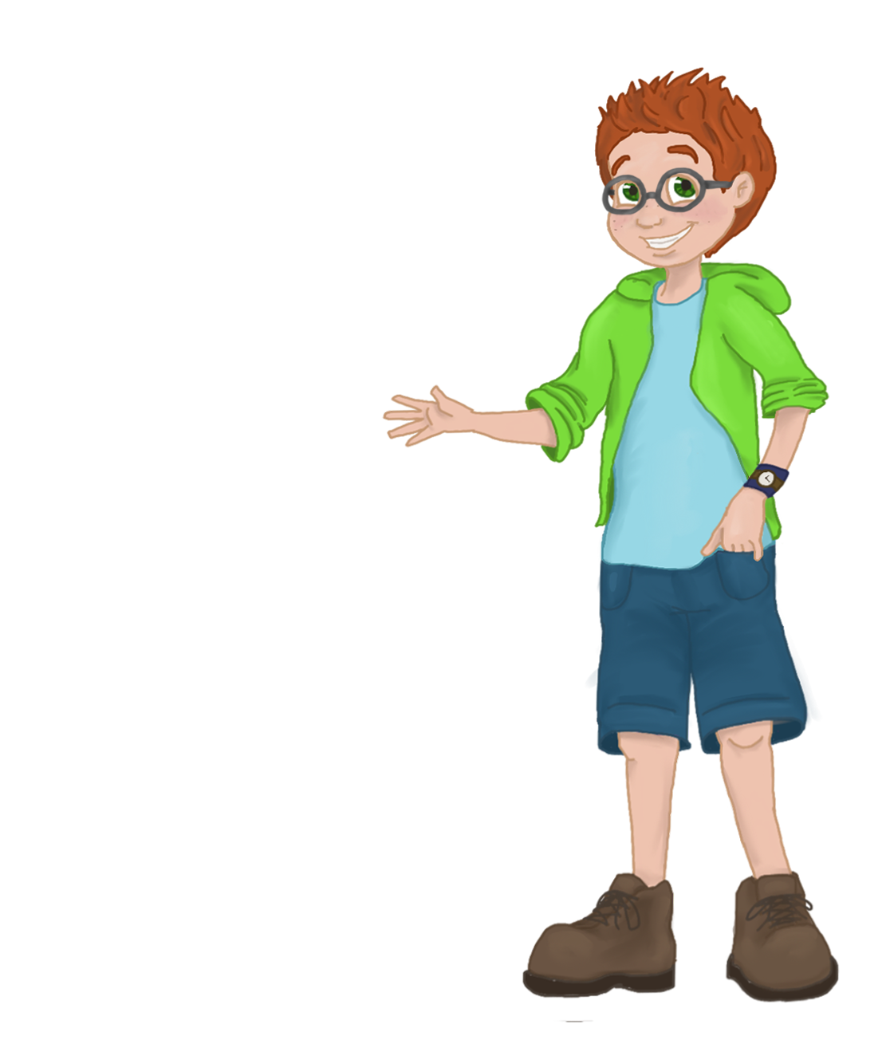
Recognizing and Supporting Success
1
0
UNIT
Parents are stronger, braver and smarter than they think.

Slide 26
Words of Wisdom
9
UNIT
“The best inheritance a parent can give his children is a few minutes of his time each day.”
-Orlando A. Battista

