Slide 1


Welcome to:
Loving Solutions

Slide 2
Concrete Solutions for Tough Kids
7
UNIT
Unless You Need the Exercise, Dig Where the Gold Is!

Slide 3
Objectives:
7
UNIT
Practice combining Set and Self-Limiting Time Outs
Identify effective interventions for out-of-control behaviors
List the 3 steps of effective Action Plans

Slide 4
Before we Begin
7
UNIT
Group Facilitator
Group Recorder
Group Time Keeper
Nurturers / Cheerleaders
Don’t forget to change roles!

Slide 5
Stories of Success
7
UNIT
Did you identify a homework spot?
Did you contact your child’s teacher?
What did you learn about your child’s school situation?
Did you begin using the HWAS?
What was your child’s reaction?

Slide 6
Activity 7.1: Let’s Focus
7
UNIT
Teen alcohol and drug use
Arrest for fighting

Slide 7
Combining Set & Self-Limiting Time Outs
7
UNIT
Helps children develop self discipline
Will eventually shorten and or eliminate, our child’s open refusals and tantrums

Slide 8
Developing a Plan
7
UNIT
Helps kids focus on their behavior
Is an effective teaching tool
Assists children in problem solving
Decreases the behavior
Redirects kids from emotional responses to thoughtful solutions

Slide 9
Activity 7.2: Screaming
7
UNIT
“I hate Time Out and I’m gonna make sure you know it.”

Slide 10
Sibling Rivalry
7
UNIT
Two Step Consequence:
Ask children to develop their own plan
Only when the siblings agree, can they move from their time out spot

Slide 11
Out-of-control Behaviors
7
UNIT
Self-Limiting Time Outs are the answer
No matter how long it takes, parents must win this battle!

Slide 12
Activity 7.3: Angela
7
UNIT

Slide 13
Groundings
7
UNIT
Used with older children, 7-10 years
Reserved for severe or ongoing behaviors
Used only when 3 to 4 weeks of standard time outs has failed to bring behavior change

Slide 14
Activity 7.4: He Did What?
7
UNIT

Slide 15
Effective Action Plans
7
UNIT
Tell your child how you feel
Establish the rule and expect success
I will . . . everything you will do to support success

Slide 16
Activity 7.5: Planning
7
UNIT
When?
Location?
Minimize Interruptions:
My plan:
Step 1
Step 2
Step 3

Slide 17
Natural Consequences
7
UNIT
“A man who carries a cat by the tail learns something he can learn in no other way.”
-Mark Twain

Slide 18
Activity 7:6: Personal Action Plans
7
UNIT
I Love . . .
I want . . .
I will . . .
Active supervision
Consequences
Consistency
What else

Slide 19
Activity 7.7: Key Points
7
UNIT
  1. An effective Three Step Action Plan should be developed by parents for ______________unwanted behavior they want to change.
  2. When consistent use of short term Time Outs fails to stop unwanted behaviors, parents may want to consider using _______________ Time Outs (up to 24 hours).
  3. Parents should avoid rescuing children from the ________________ consequences of their behavior.
  4. When parents discipline their children, they should take away _________________ on their Child's List for a ____________________ period of time.
  5. When children have used tobacco in the past, parents should occasionally do ________________ ______________ on their children when they are at a friend's house to ensure they are not smoking or chewing tobacco.
  natural checks every Extended short spot everything

Slide 20
Most Powerful
7
UNIT

Slide 21
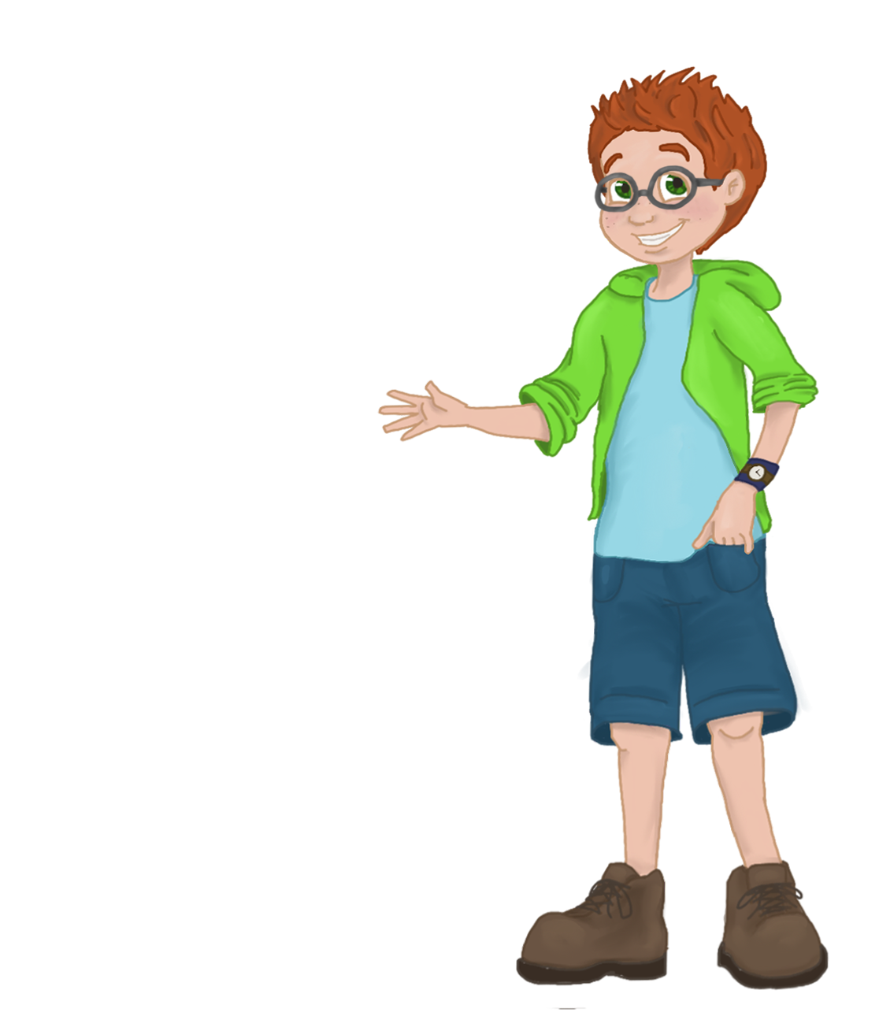
Sleep, Diet, and Behavior
8
UNIT
The (not so) Hidden Connection

Slide 22
Words of Wisdom
7
UNIT
“The greatest predictor of violent behavior is harsh, erratic parental discipline.”
-U.S. Department of Justice

