Slide 1

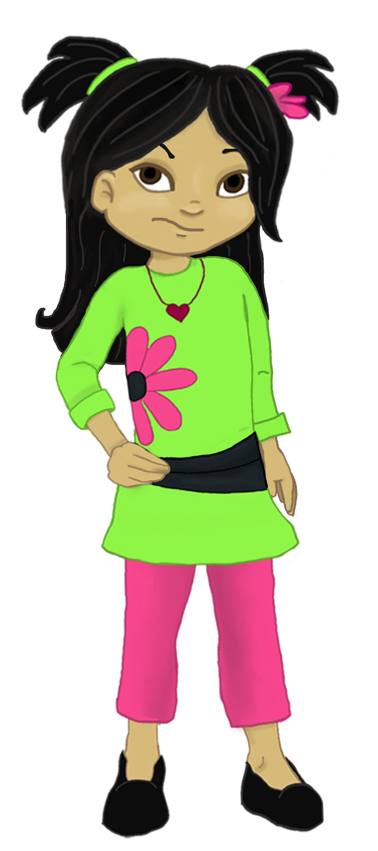
Welcome to:
Loving Solutions

Slide 2
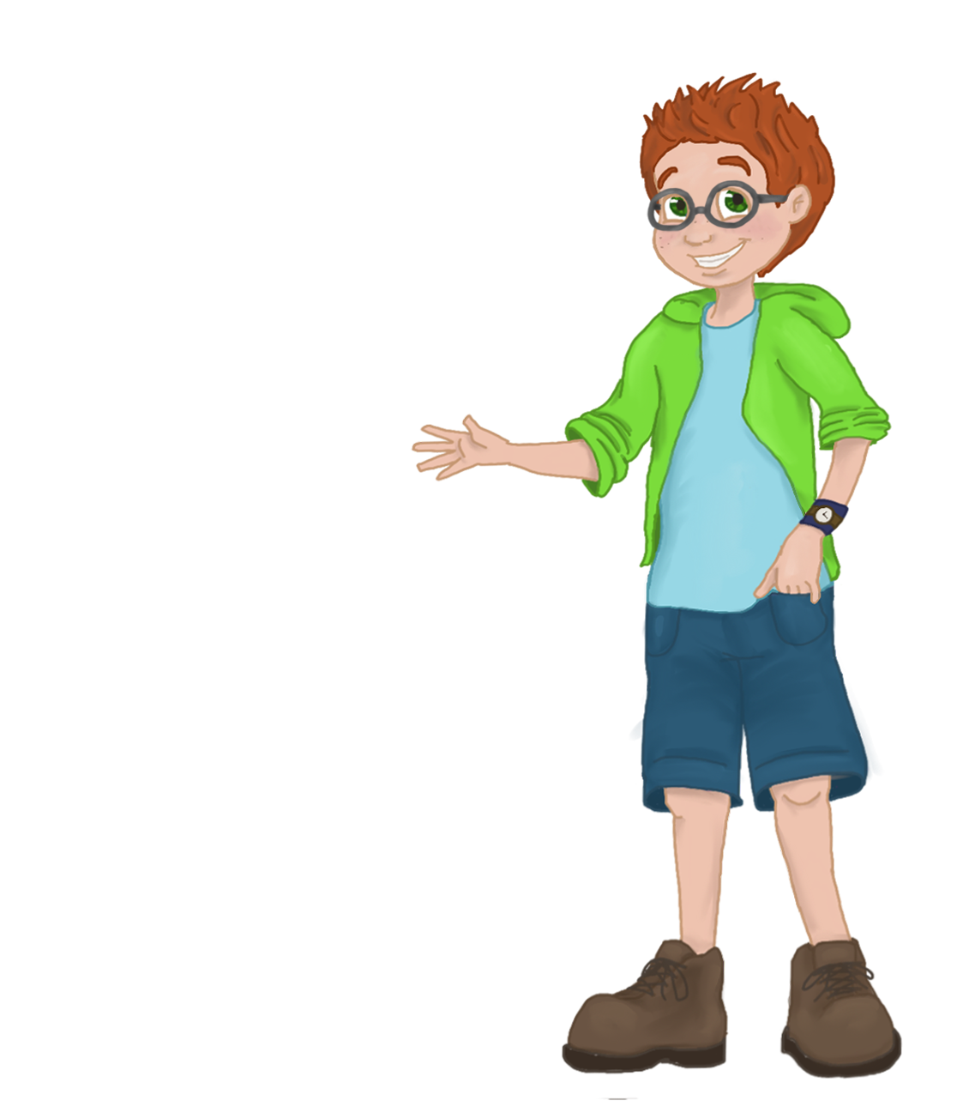
Improving
School Performance
6
UNIT
Setting the Stage for Life-Long Educational Success

Slide 3
Objectives:
6
UNIT
Communicate effectively with our child’s teachers.
Implement the homework assignment sheet.
Structure the home environment to help ensure daily homework is completed.

Slide 4
Before We Begin
6
UNIT
Group Facilitator
Group Recorder
Group Time Keeper
Nurturers / Cheerleaders
Remember to change roles!

Slide 5
Sharing Our Progress
6
UNIT
What did you discover about your child’s friends and home situations?
What items are potentially harmful to your child?
Did you do anything to reduce and monitor your child’s use of technology?

Slide 6
Activity 6.1: Let’s Focus
6
UNIT
Loss of self-esteem
Loss of interest in school

Slide 7
Building Gritty Kids
6
UNIT
Gritty Kids:
Are structured
Complete tasks
Understand that failure is often a necessary step to success
(Smart parents praise their children for their effort)

Slide 8
Grit in Adults
6
UNIT
“It is not that I am so smart, it’s just that I stay with problems longer.”
-Albert Einstein

Slide 9
Activity 6.2: Motivation
6
UNIT
Content Goes Here as Needed

Slide 10
Activity 6.3: The Right Spot
6
UNIT

Slide 11
Parent Involvement
6
UNIT
Volunteer at your child’s school
Know the resources in your community
Parents as advocates / decision makers
Home / School communication
Home learning activities
Basic parenting skills

Slide 12
Home / School Communication
6
UNIT
Communicate positively 6 times with teachers . . . your child’s grades go up

Slide 13
Activity 6.4: Doing it Right
6
UNIT

Slide 14
Communication Tips
6
UNIT
Help teachers to better understand your child
Ask teachers about their expectations
Ask teachers for their preferred method of communication
Be diplomatic, don’t put school staff on the defensive
Give teachers a few days to get back to you
Be solution focused, don’t play the “blame game”

Slide 15
Homework Accountability
6
UNIT
Ensure a Homework Assignment Sheet is completed
Approve the child’s homework when finished
Control the “Child’s List of things” until homework is complete
Acknowledge success with a positive stroke, (Praise the effort, not the talent)

Slide 16
Homework Assignment Sheet
6
UNIT

Slide 17
Activity 6.5: Monitoring
6
UNIT

Slide 18
Developing Homework Behavior
6
UNIT
Accountability + Motivation = Change
(HWAS) + Child’s List = Homework)

Slide 19
Activity 6.6: Excuses
6
UNIT
Excuses:
Dog ate it
Consequence:

Slide 20
Activity 6.7: Key Points
6
UNIT
1. Active supervision can be described by five simple words: Who,________________________, Where, _________________ and Why.
2. Parents should communicate _____________ with their child's teachers at least ___________ times per year.
3. Parents play the ________ role in the education of their children.
4. A Daily Homework ___________ ____________ can help parents monitor the homework their child has.
5. When children refuse to do their homework, parents should take away _____________ on their Child's List of things until the homework is____________.
Assignment Sheet What everything six
When finished key positively

Slide 21
Most Powerful
6
UNIT

Slide 22
Concrete Solutions for Tough Kids
7
UNIT
Unless You Need the Exercise, Dig Where the Gold Is!

Slide 23
Words of Wisdom
6
UNIT
“Everybody is a genius. But if you judge a fish by its ability to climb a tree, it will live its whole life believing it is stupid.”
  -Albert Einstein

