Slide 1

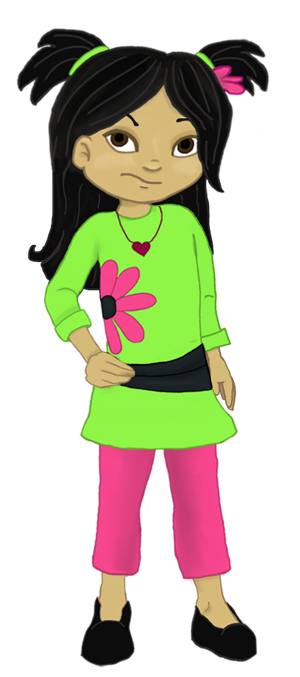
Welcome to:
Loving Solutions

Slide 2
Structuring
For Success
5
UNIT
Building Blocks That Work

Slide 3
Objectives
5
UNIT
Discuss the necessity of structure for children
Recognize ways parents can help children structure their time
List the elements of Active Supervision
Identify media tools and items that can be harmful to children

Slide 4
Before We begin
5
UNIT
Group Facilitator
Group Recorder
Group Time Keeper
Nurturers / Cheerleaders
Remember to change roles!

Slide 5
Sharing Our Progress
5
UNIT
Did you find an opportunity to give your child an ‘I Love’ message for a positive choice?
How were you able to keep from arguing with your child last week?
Did you use a Self-Limiting Time Out?
What happened?

Slide 6
Activity 5.1: Let’s Focus
5
UNIT
Play organized sports
Develop a hobby

Slide 7
Busy, Busy, Busy
5
UNIT
At Home:
Develop a hobby
Become an expert
Play with your child
Help make dinner
Read to your child
Help with chores
Exercise with your children
Help your child become a problem solver

Slide 8
Busy, Busy, Busy
5
UNIT
In the Community
Play organized sports
Take your child with you when you volunteer
Get involved in youth clubs

Slide 9
Busy, Busy, Busy
5
UNIT
At School:
After school programs and clubs
School plays and clean up projects
After school sports
Parents: volunteer with at least one of the above
Talk with your child about the good stuff at school
At Church:
Sign up for youth groups and community service projects

Slide 10
Activity 5.2: Busy Kids
5
UNIT
Home:
Community:
School:
Church:

Slide 11
Activity Supervision
5
UNIT
Who:
What:
Where:
When:
Why:

Slide 12
Activity 5.3: Supervision
5
UNIT
Who:
What:
Where:
When:
Why:

Slide 13
Responding to our children
5
UNIT
Definitely a winner
In the ball park
persuade me
Negotiate
later
Not while I draw breath

Slide 14
Spot Checks
5
UNIT
Necessary part of Active Supervision
Not an issue of trust

Slide 15
Media and Technology
5
UNIT
TV’s
Video Games
Cell phones
Computers
Internet
Music

Slide 16
Activity 5.4: Violence
5
UNIT
Video games

Slide 17
Video Games
5
UNIT
Absolutely no constructive good comes from a child playing violent video games!

Slide 18
Structure
5
UNIT
Children need a structured home environment.

Slide 19
Activity 5.6: Daily Activities
5
UNIT
Play video games
Ride bicycles
Go to school
Make his / her bed

Slide 20
Structure & Supervision
5
UNIT
Structure is not punishment
Helps children accomplish constructive tasks

Slide 21
Activity 5.7: Key Points
5
UNIT
1. Active supervision can be described by five simple words: Who, ____________________, Where, __________________ and Why.
2. Parents should occasionally _____________________on their children to ensure they are safe.
3. When placing a child on Time Out, parents should remove all ________________ from the child.
4. Parents should limit their children's video game time to no more than ______ hour per day.
5. Parents should use a Self-Limiting Time Out when children ______________ to complete requested tasks.
  ^{check reinforcers What}
  ^{When refuse} ^{one}

Slide 22
Most Powerful Ideas
5
UNIT

Slide 23
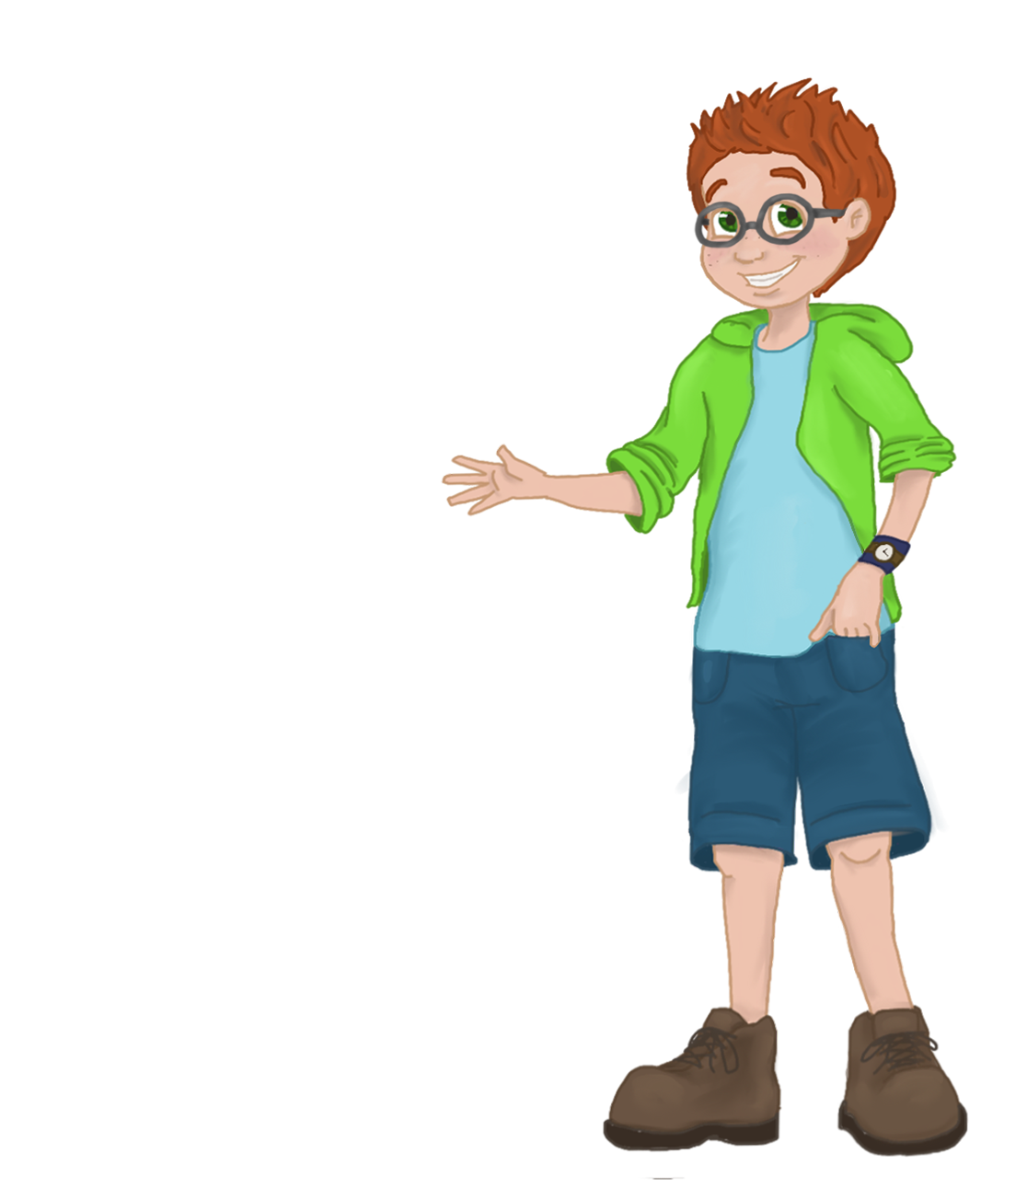
Improving
School Performance
6
UNIT
Setting the Stage for Life-Long Educational Success

Slide 24
Slide Titles Go Here
5
UNIT
“A child, like your stomach, doesn’t need all you can afford to give it.”
-Frank A. Clark

