Slide 1

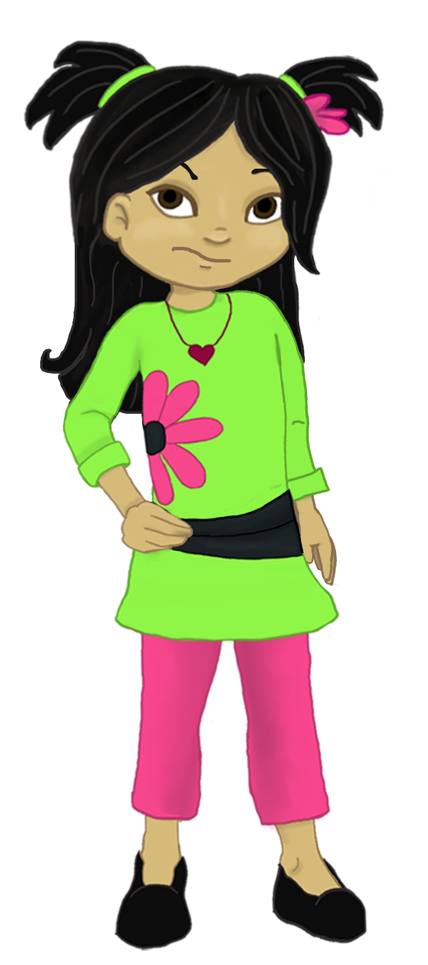
Welcome to:
Loving Solutions

Slide 2
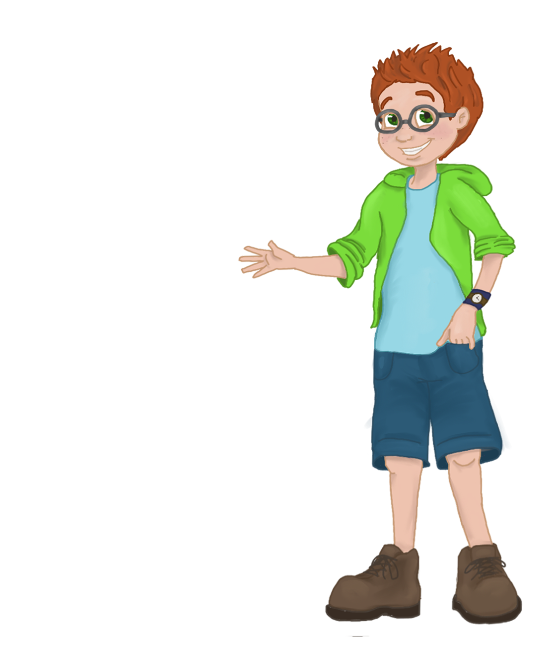
Redirecting Negative Choices
4
UNIT
Creativity is No Substitute for Knowing What You Are Doing

Slide 3
Objectives:
4
UNIT
List 5 tips to consider before addressing problem behavior
Develop I love redirecting messages
Discuss why words alone will not motivate many children to change
Describe the negative messages we send when we are inconsistent

Slide 4
Before We Begin
4
UNIT
Group Facilitator
Group Recorder
Group Time Keeper
Nurturers / Cheerleaders
Don’t forget to change roles.

Slide 5
Sharing Our Progress
4
UNIT
Did you share your Guiding Life Principles with your family?
What was their response?

Slide 6
Activity 4.1: Let’s Focus
4
UNIT
I’m just not good enough.
Mom does not like me.

Slide 7
Couch Parenting
4
UNIT
“When parenting, if you find yourself saying, ‘This is easy,’ you’re probably doing it wrong.”

Slide 8
Redirecting Negative Choices
4
UNIT
Address the behavior, but avoid attacking the child.

Slide 9
5 Tips
4
UNIT
Timing
Private, neutral location
Minimize interruptions
Develop a plan
Prepare yourself for the worse

Slide 10
Activity 4.2: Planning
4
UNIT
Timing?
Location?
Interruptions?
What’s my plan?
What is the worst?

Slide 11
How to begin?
4
UNIT
I love . . .
I see . . .
I feel . . .
(Shhhh) Just listen
I want . . .
I will . . .

Slide 12
Activity 4.3
4
UNIT
I love . . .
I see . . .
I feel . . .
(Shhhh) Just listen
I want . . .
I will . . .

Slide 13
What to expect?
4
UNIT
Some possibilities:
Anger
Denial
Blame

Slide 14
Parents Should
4
UNIT
Remain calm and listen
Return to the original reason for the conversation
Clarify your expectations and rules
Identify the consequences and or, provide more structure
Always end it on a positive note

Slide 15
Parents should not:
4
UNIT
Insist children look at them
Apologize for the meeting
Judge the child
Preach or lecture
Try to scare your child
Compare your child to others
Use sarcasm, ridicule or pressure

Slide 16
Activity 4.4: Duh!
4
UNIT

Slide 17
Persistent Arguing
4
UNIT
Don’t give in!

Slide 18
When Children Refuse
4
UNIT
Move to a Self-Limiting Time Out

Slide 19
Activity 4.5: She Refuses
4
UNIT
What’s the Plan?
Easy Stuff or Tough as Nails?

Slide 20
Consistency
4
UNIT
Always enforce your house rules
Consistency is more important than the length or strength of the consequence (Time Out)

Slide 21
Activity 4.6: It’s Tough!
4
UNIT
Parent does not like to see child unhappy
Child screams when placed on Time Out

Slide 22
Activity 4.7: Inconsistency
4
UNIT
When were we inconsistent?
What caused it?
What messages did we send?

Slide 23
The Wrong Message
4
UNIT
Children’s sense of self worth can be directly attributed to the messages received from their parents.

Slide 24
Activity 4.8: Positive Messages
4
UNIT
Love and Affection:
Positive strokes:
Active Listening:
Better grades:
Family activities:
Active Supervision:
I love Messages:
Positive Consequences:

Slide 25
Activity 4.9: Key Points
4
UNIT
1. Children are generally driven by _______________.
2. Parents should ______________ themselves before they address problematic behaviors with their children.
3. Parents should always be calm when they_____________ their children about problematic behaviors.
4. Children may need a ________________ ________________ Time Out, before they complete a task they see as work.
5. Parents should use ___ Love ____________ to both encourage their children's positive behaviors as well as redirect negative choices.
  ^{confront emotion I prepare}
  ^{Self Limiting Messages}

Slide 26
Most Powerful
4
UNIT

Slide 27
Structuring
For Success
5
UNIT
Structuring our Home Environment
Today’s Media and Technology
Active Supervision

Slide 28
Words of Wisdom
4
UNIT
“Words that soak into your ears are whispered, not yelled.”
(Unknown)

