Slide 1

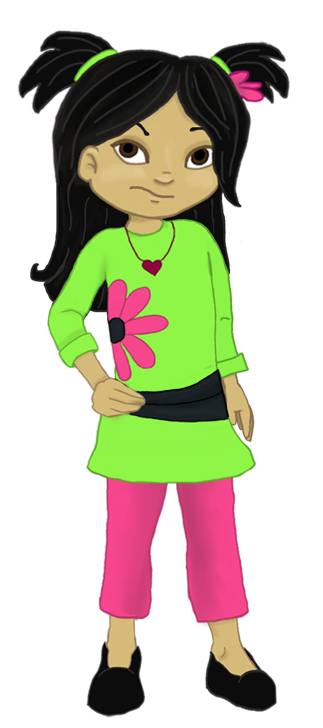
Welcome to:
Loving Solutions

Slide 2
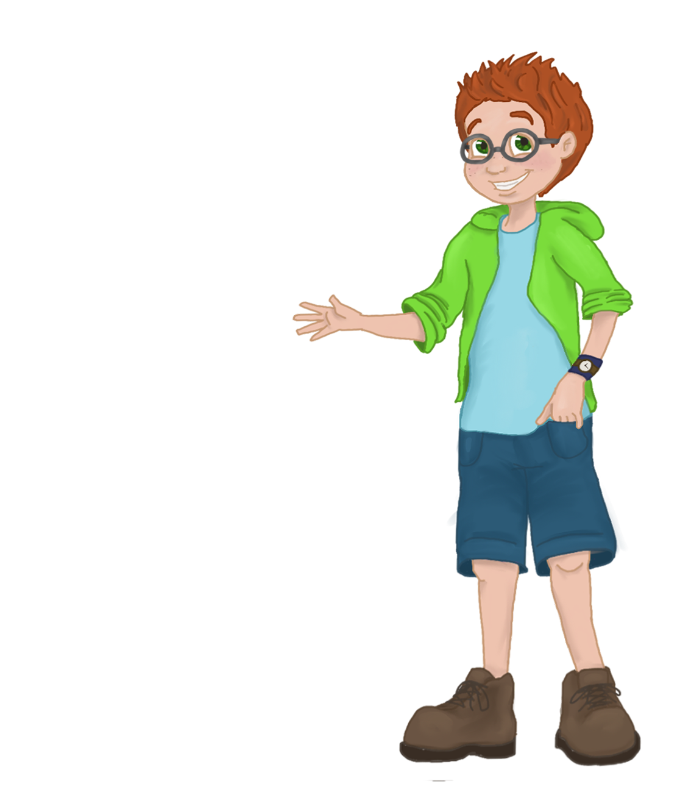
Parental
Influence
2
UNIT
Setting the Stage for Success

Slide 3
Objectives:
2
UNIT
Discuss Issues of Influence vs. Control
Recognize how children think and act
Identify house rules
Describe effective parenting strategies to decrease unwanted behaviors

Slide 4
Before We Begin
2
UNIT
Group Facilitator
Group Recorder
Group Time Keeper
Nurturers / Cheerleaders
Don’t forget to change roles!

Slide 5
Warm Up
2
UNIT
Let’s share our progress!

Slide 6
Activity 2.1: Let’s Focus
2
UNIT
Teachers
Day care workers

Slide 7
Respect
2
UNIT
“A child who is allowed to disrespect his parents will not have true respect for anyone.”
- Billy Graham

Slide 8
Influence vs. Control
2
UNIT
What do parents control?

Slide 9
Influence Vs. Control
2
UNIT
Parents control things, not children!

Slide 10
Self-Limiting Time Outs
2
UNIT
Recognize the fact that we do not control our children
Help eliminate parent / child arguments
Reduce parental lectures and nagging
Effective in obtaining parental requests.

Slide 11
Choose Your Battles
2
UNIT
Zero Tolerance Rules
Negotiable Rules
Drives Me Nuts
Let it Go

Slide 12
Activity 2.3: Zero Tolerance
2
UNIT
Not doing homework
Violent behavior
Tobacco use

Slide 13
Activity 2.4: Negotiable
2
UNIT
Clean room
Setting the dinner table

Slide 14
Activity 2.5: Drives Me Nuts
2
UNIT
Dirty clothes under the bed

Slide 15
Activity 2.6: Let it Go
2
UNIT
Immaculate room
Bathing 2 times a day
Not rolling eyes when frustrated

Slide 16
Activity 2.7: How Kids Think
2
UNIT
Children usually:
Children generally:
Children usually:
Children are more likely to:
Children respond:

Slide 17
Activity 2.8: Better Time Outs
2
UNIT

Slide 18
Effective Time Outs
2
UNIT
The Place
The Wall
The Time
The Timer
The Siblings
The Number
The Silence
The Place
The Warnings
The Stuff
Consistency
Consistency
Consistency

Slide 19
Take Everything
2
UNIT
T.E.A.S.P.O.T.
Take Everything Away for a Short Period of Time

Slide 20
ABC
2
UNIT
Appropriate
Brief
Consistent
Design

Slide 21
Activity 2.9: Practice
2
UNIT
Appropriate:
Brief:
Consistent:
Design:

Slide 22
Activity 2.10: Negative Choices
2
UNIT
Hitting
Breaking a toy on purpose

Slide 23
Activity 2.11: Key Points
2
UNIT
1. Children are generally driven by __________.
2. Fixed Time Outs are recommended as ____ minute per year of age of the child.
3. Self limiting Time-Outs are designed to get children to ______ with parental requests.
4. Parents should use Fixed Time Outs _______ __________children choose to break the house rules.
5. _______________ is more important than the ______________ of the Time Out.
emotion Consistency length negotiate every time one comply

Slide 24
Activity 2.11: Most Powerful
2
UNIT
Consistency

Slide 25
Encouraging Positive Choices
3
UNIT
Getting More of What We Really Want for Our Children

