Slide 1

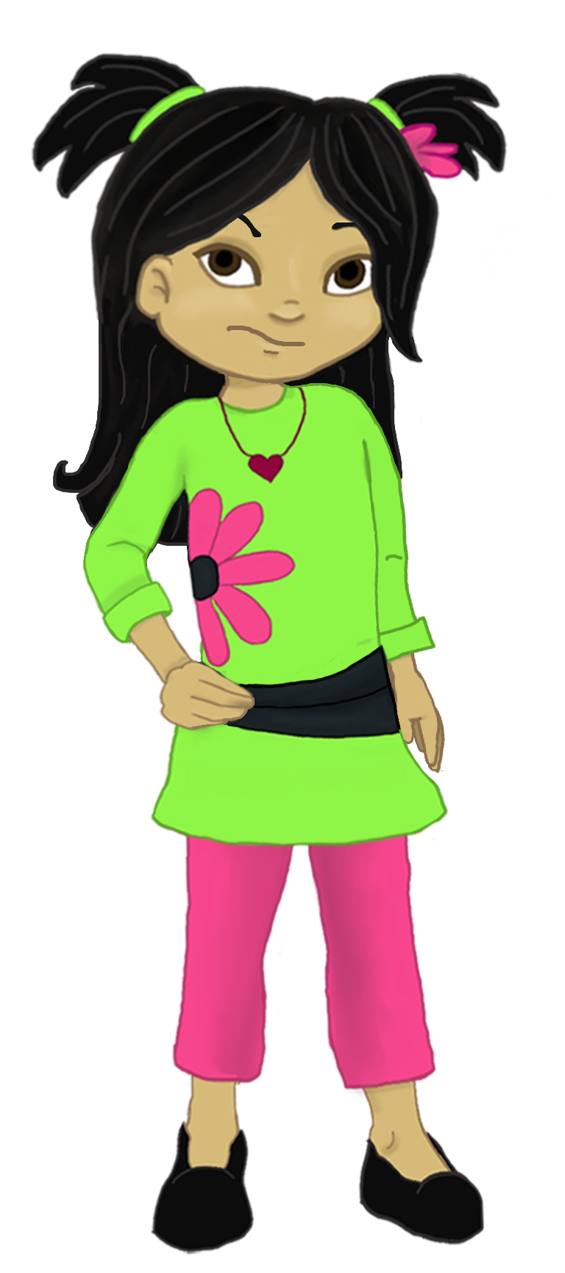
Welcome to:
Loving Solutions

Slide 2
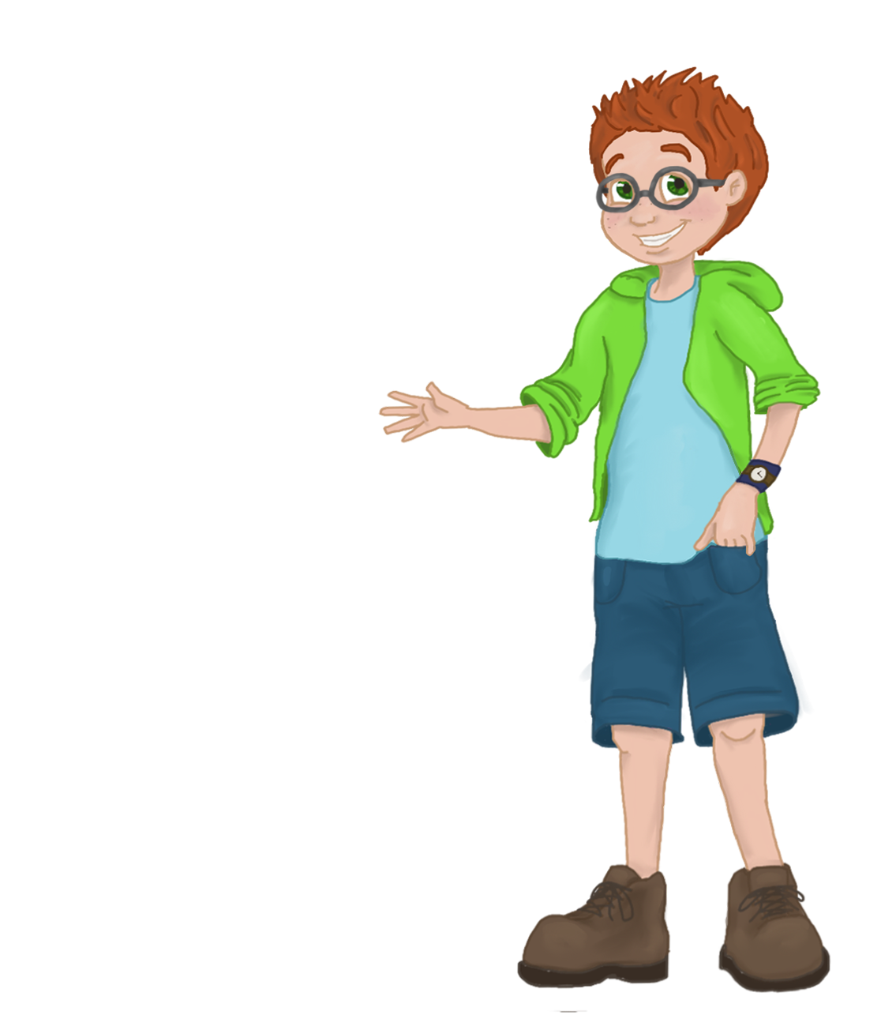
Recognizing and
Supporting Success
1
0
UNIT
Parents are stronger, braver and smarter than they think!

Slide 3
Objectives
10
UNIT
Discuss the benefits of the support group process
Facilitate a support group meeting

Slide 4
Before We Begin
10
UNIT
Group Facilitator
Group Recorder
Group Time Keeper
Nurturers / Cheerleaders
Don’t forget to change roles!

Slide 5
Stories of Success
10
UNIT
What strategy did your family choose?
What was your family’s reaction?

Slide 6
Program Review
10
UNIT
Set aside time for your child everyday
Pay attention to your child
Be prepared
Find support for yourself

Slide 7
Activity 10.1: Key Strategies
10
UNIT
Some ideas can be matched to more than one strategy!

Slide 8
Activity 10.2: Sharing
10
UNIT
Think Back

Slide 9
Activity 10.3: Group Help?
10
UNIT
How has your group helped you?

Slide 10
Regrouping
10
UNIT
Elect New Group Roles. Then introductions
Name
Name & ages of your children
Current concerns
What you hope to get out of the support group process

Slide 11
Activity 10.4: Preparation
10
UNIT
When and where will you meet?

Slide 12
Activity 10.5: Connections
10
UNIT
Let’s exchange
phone numbers

Slide 13
Working in Groups
10
UNIT
Right to Pass
Time Limits
Democracy
Active Listening

Slide 14
W.I.S.E. Advice
10
UNIT
Willing:
Informed
Success
Empathy

Slide 15
Activity 10.6: W.I.S.E Advice
10
UNIT
Yes / No Why?
Yes / No Why?
Yes / No Why?
Yes / No Why?
Yes / No Why?

Slide 16
Activity 10.7: Confidentiality
10
UNIT
Remember, in Unit 1 we said, “What happens in Vegas, stays in Vegas.”
Now it’s your group. How do you want it to work?

Slide 17
Recommendations:
10
UNIT
Start meetings on time
Sit in circles, no tables
End meetings on time
Use the support group format

Slide 18
Activity 10.8: Key Points
10
UNIT
1. Parents should tell their children how much they are loved every _____________ .
2. If parents have a strong-willed child, traditional parenting techniques may not________________.
3. Short-term consequences are more effective because they fit they way children____________ .
4. Parents should give their children positive ___________________ when they catch their children doing something right.
strokes think work day
5. Finally, working by yourself, what was the most powerful idea you personally learned from this COURSE? ______________________

Slide 19
Most Powerful?
10
UNIT

Slide 20
Words of Wisdom
10
UNIT
“Romance fails us and so do friendships, but the relationship of parent and child, less noisy than all others, remains indelible and indestructible, the strongest relationship on earth.” – Theodor Reik

