Slide 1

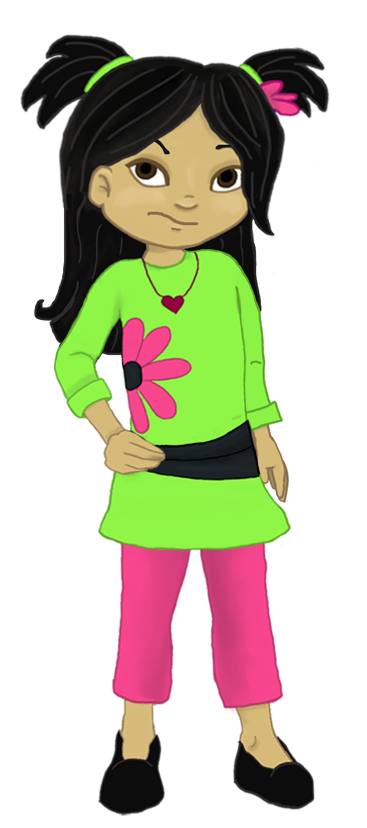
Welcome to:
Loving Solutions

Slide 2
Program Overview
10 Units of Instruction
Designed specifically for parents raising strong-willed, highly impulsive, or special needs children.

Slide 3
Program Goals
Reduce family conflict
Increase self discipline
Improve school performance
Identify negative influences
Provide concrete solutions for special needs children

Slide 4
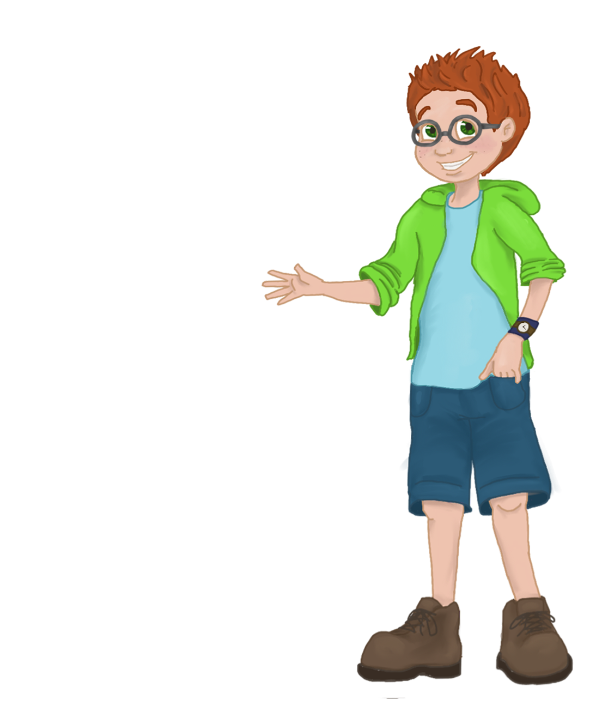
Meet Max & Jenni, the kids will:
Help us to better understand how kids think
Help us laugh

Slide 5
Parenting the Strong-Willed Child
1
UNIT
Laying the
Foundation

Slide 6
Objectives:
1
UNIT
Strong-willed vs. Compliant Kids
Power of Love and Affection
Limits of Communication
Discuss strategies to increase cooperation and positive behaviors

Slide 7
Before We Begin Unit 1
1
UNIT
Your partner’s name?
Name and ages of their children?
What parenting concerns does your partner have?
What does your partner hope to learn from this class?

Slide 8
Strong-willed vs. Compliant Kids
1
UNIT
Strong-Willed
Argumentative
Persistent
Frustrating
Compliant
Easy-going
Listen
Eager to please

Slide 9
Activity 1.1: Personality
“They tell me I can be difficult and I argue a lot. I don’t think that’s true.”

Slide 10
What Works?
Love and Affection
Positive Strokes
Positive Consequences
Negative Consequences

Slide 11
Love and Affection
Our most effective parenting tool and the key to:
Communication
Discipline
Self-esteem
Changing destructive and difficult behaviors

Slide 12
Group Roles
Groups work best with:
Group Facilitator
Group Recorder
Group Time Keeper
Group Cheerleaders / Nurturers

Slide 13
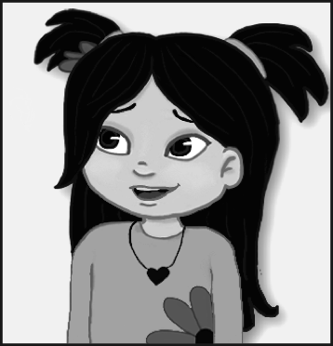
Activity 1.2: Roles
This will be fun. Can I be a cheerleader?

Slide 14
Ground Rules
Active Listening
Confidentiality
Don’t be Judgmental
Quantity vs. Quality
Okay to “Piggy Back”

Slide 15
Activity 1.3: Showing Love
Say I love You
Cooking for your children
Spending time with your children

Slide 16
Activity 1.4: Most Effective
?
?
?

Slide 17
Positive strokes
“I can live for two months on a good compliment.”
                Mark Twain

Slide 18
Activity 1.5: Doing Right
Taking out the trash
Helping a younger brother / sister

Slide 19
Limits of Communication
Stop Repeating Yourself!

Slide 20
Positive Consequences
The most powerful method of shaping behavior!

Slide 21
Positive Consequences
Example:
Employees get a paycheck at the end of the work week.

Slide 22
Activity 1.6: Fun Follows Work
Don’t forget to use the words “Sure” or “Absolutely”

Slide 23
Influence vs. Control
Parents control things, not children!

Slide 24
Activity 1.7: Child’s List

Slide 25
Time Outs (Two Types)
Self-Limiting Time Out
Child determines the length of time
Set Time Out
Parents set the amount of time

Slide 26
Activity 1.8: Unfun Tasks
Child needs to complete homework
Child needs to pick up his toys

Slide 27
Self-Limiting Time Outs
Used to encourage positive behaviors
No set time period
Length of time determined by the child
Child takes as much time as he needs or chooses to complete task

Slide 28
Self-Limiting Time Outs
“Take as much time as you need.”
A powerful statement!

Slide 29
Activity 1.9: Key Points
  1. If parents have a strong-willed child, traditional parenting techniques may not________________.
  2. Parents must tell their children how much they are loved every ___________________.
  3. Although parents cannot control their children, parents can control the _______________ their children enjoy.
  4. Parents should give their children positive _______________________ when they catch their children doing something right.
  5. When children refuse to do a requested task, parents should use a ______ __________ Time Out.
  strokes day work Short Self
  ^{Limiting things}

Slide 30
Activity 1.9: Most Powerful

Slide 31
Next Week
2
UNIT
Maximize our
Parental Influence

Slide 32
Words of Wisdom
“I wish I would have held you closer, hugged and kissed you more when you were little.”

